Slide 1
7 Aspects of Manifestation of Holy Spirit

Slide 2
1 Corinthians 12:7
Now to each one the manifestation of the Spirit is given for the common good.

Slide 3
Understanding the word: “SPIRIT”
  Human spirit
  Holy Spirit
  Satanic spirit
  School of thought

Slide 4
Human spirit
I Thessalonians 5:23 (NKJV)
Now may the God of peace Himself sanctify you completely; and may your whole spirit, soul, and body be preserved blameless at the coming of our Lord Jesus Christ.

Slide 5
Holy Spirit
Revelation 3:6 (NIV)
Whoever has ears, let them hear what the Spirit says to the churches.

Slide 6
Satanic Spirit
Mark 9:26 (NKJV)
Then the spirit cried out, convulsed him greatly, and came out of him.

Slide 7
School of thought
Luke 9:55 (NKJV)
But He turned and rebuked them, and said, “You do not know what manner of spirit you are of”.

Slide 8
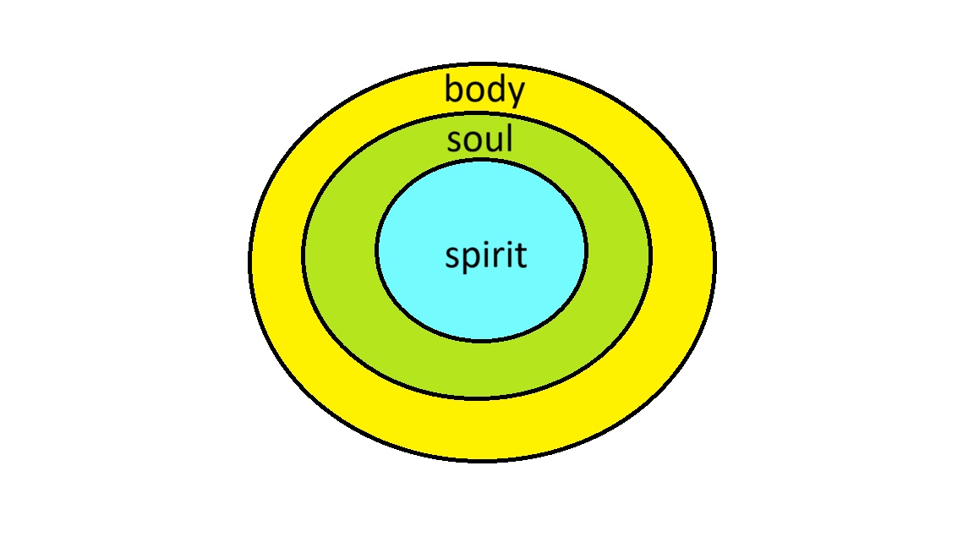

Slide 9
2. Manifestation in the Human spirit.

Slide 10
3. Manifestation in the Human soul.

Slide 11
4. Manifestation in the flesh (body).

Slide 12
5. Manifestation among believers to benefit them.

Slide 13
6. Manifestation among the non-believers to benefit them.

Slide 14
7. Manifestation in the Physical Realm.
Through fruit of the Spirit.
Through gifts of the Holy Spirit.

